Slide 1
Student Name
: Mr. VELMURUGAN U
Class
: II MCA
Roll No
: 717824Z154
Batch
: 2024-2026
Course Code & Name : 23EXC302 & Mini Project
Deepfake Image Detection Using Color Channel Co-occurrence Matrices and Convolutional Neural Networks
Guide Name : Dr. P. SHANTHI

Slide 2
1.Introduction
Deepfake technology uses AI to generate highly realistic fake images. These synthetic images closely resemble real faces, making detection extremely challenging.
The rapid growth of GANs improves manipulation quality continuously. As these generative models advance, visual inconsistencies become harder to identify.
Deepfakes pose risks in misinformation, impersonation, and digital security. The misuse of fabricated images threatens privacy, trust, and online communication.
Researchers worldwide propose various detection methods to counter deepfakes. These methods differ in feature extraction, datasets, and accuracy performance.

Slide 3
2.Abstract
Deepfake technology has advanced significantly, producing highly realistic manipulated facial images. These images often appear indistinguishable from real ones, making manual detection unreliable.
The increasing sophistication of generative models raises concerns about privacy and digital trust Deepfakes contribute to misinformation, identity misuse, and security threats across digital platforms.
The analysis covers handcrafted texture-based methods, CNN-based techniques, and frequency-domain models. Additionally, hybrid architectures and transformer-based systems are reviewed for their performance benefits.
Each paper is evaluated based on feature extraction strategy, dataset used, and detection accuracy. This comparison provides insights into how design choices impact robustness and generalization.

Slide 4
3.Existing system
The survey focuses on deepfake image detection, not video manipulation. This allows a deeper analysis of still-image forensic techniques.
The study covers texture-based, deep learning, frequency domain, and transformer models. Each category contributes unique insights into effective deepfake detection.
Only peer-reviewed and high-quality research papers from 2018–2024 are included. This ensures the study reflects modern advancements in deepfake technology.
The scope includes analyzing feature extraction, datasets, and evaluation methods. These factors together determine the reliability of each detection approach.
The survey identifies recurring issues such as dataset bias and poor generalization. Highlighting these issues helps in understanding why some models perform inconsistently.

Slide 5
4.Limitations on Paper
Most papers rely on limited or single datasets. This causes poor generalization when detecting unseen deepfake styles.
Handcrafted features struggle against high-quality GAN images. Modern deepfakes hide pixel artifacts too well for classical techniques.
Deep learning models require large computational resources. This makes deployment difficult on mobile or real-time environments.
Transformer models need very large training datasets. Limited data often leads to overfitting and unstable performance.
Lack of explainability in most detection models. This reduces trustworthiness in forensic or security investigations.

Slide 6
5.Comparative Insights
Differences in Dataset Quality and Diversity
Some papers use small or single-source datasets, causing limited generalization.
Studies with diverse datasets (Celeb-DF, DFDC, FaceForensics++) show more reliable and stable accuracy.
Robustness Against Real-World Manipulations
Methods relying only on RGB features degrade heavily under compression and noise.
Frequency-domain and hybrid models perform better in low-quality or social-media–like conditions.
Impact of Feature Selection Choices
Simple pixel or grayscale features miss high-level semantic clues.
Hybrid systems combining texture, frequency, and CNN features achieve the best cross-dataset performance.

Slide 7
6. Feature Extraction Technique
Texture-Based Extraction (GLCM, LBP)
Captures micro-textures and co-occurrence relationships in pixel intensity.
Effective for identifying subtle inconsistencies in fake images.
CNN-Based Deep Feature Extraction
Learns hierarchical image patterns using convolutional layers.
Highly accurate but requires large data and GPU resources.
Hybrid Feature Extraction
Combines texture + deep features or frequency + CNN patterns.
Provides stronger robustness and better performance across datasets.
Transformer-Based Feature Extraction
Utilizes Vision Transformers (ViT) to capture long-range spatial relations.

Slide 8
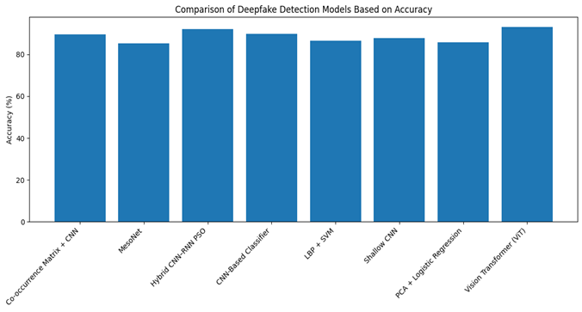
7.Accuracy Chart

Slide 9
8.Conclusion
Deepfake detection performance varies widely
Hybrid architectures show promising results
Dataset diversity remains a major limitation
Deep learning models outperform classical techniques
Feature extraction plays a critical role

Slide 10
9.future Enhancement
Develop more robust hybrid models
Integrate real-time detection capability
Expand to multi-modal deepfake detection
Enhance dataset diversity and realism
Deployment in real-world platforms
Improve explainability and interpretability

Slide 11
Any Queries
Thank you
15

